Slide 1
ASIFlex Card
MoneyPlus and Health Savings Accounts
2024

Slide 2
Important information
This overview is not meant to serve as a comprehensive description of the insurance benefits offered by PEBA.
More information can be found in the following:
Benefits Administrator Manual; and
Insurance Benefits Guide.
The plan of benefits documents, certificates of coverage and benefits contracts contain complete descriptions of the insurance benefits offered by or through PEBA. Their terms and conditions govern all these benefits.

Slide 3
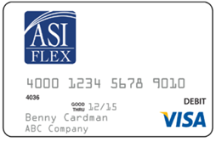
ASIFlex Card
Issued to MSA and Limited-use MSA participants and valid for five years.
Two cards mailed to home address on file.
Upon receipt, call to register and set up PIN.
Order additional cards through ASIFlex Online.
Can use card as credit transaction or debit transaction.
Report lost or stolen card immediately.

Slide 4
Documentation
Use of the card is optional and may require documentation.
IRS has strict regulations about appropriate use of the ASIFlex Card.
Each time the card is used, participant should ask the provider for an itemized statement of service that shows:
Provider name;
Patient name;
Date of service;
Description of service; and
Dollar amount owed.
Participants should be sure to have the itemized receipt before leaving; providers do not automatically provide.
Participants should keep paper copy or snap a picture to save on mobile device.

