Slide 1
Employer Advisory Group
Employer Services
November 2024

Slide 2
Topics
PEBA:Connect.
Important reminders.
Insurance.
Retirement.

Slide 3
PEBA:Connect

Slide 4
PEBA:Connect
Extensive project to replace PEBA’s core operating systems.
PEBA continues to work with our vendor, TELUS Health, on the development and use of automated systems and processes.
Once the new system is deployed, employers will experience significant changes in administering PEBA benefits. You will learn a new way to conduct business with PEBA. Our objective is to make it easier and more efficient for employers.
Learn more at peba.sc.gov/peba-connect.

Slide 5
PEBA:Connect
The new system will provide a unified, one-stop improved customer experience with respect to all programs administered by PEBA.
  There will be one secure portal through which employers conduct business with PEBA.
The new system and processes will enhance existing Customer Service capabilities for members and employers.
The new system will integrate retirement and insurance processes, where further integration will improve operations and/or the efficiency and delivery of excellent services to customers.

Slide 6
Important reminders

Slide 7
Employer training
peba.sc.gov/insurance-training and peba.sc.gov/retirement-training.
Manuals are valuable resources to walk employers through procedures and explain PEBA rules.
  Benefits Administrator Manual (insurance); and
  Covered Employer Procedures Manual (retirement).
PowerPoints and recorded presentations are available online.
Online sessions, including the Employer Advisory Group, are announced in PEBA Update.
Other resources are specific, shorter training documents or videos.
Request a one-on-one virtual meeting with Employer Services for any specific need.
EmployerServices@peba.sc.gov.

Slide 8
Weekly e-newsletter
It’s important to stay connected through PEBA Update, our e-newsletter to employers.
Valuable employer resources that include important updates and announcements from PEBA.
Archived newsletters available at peba.sc.gov/peba-update.
Distribution list comes from employer contacts with a valid email address in the employer portal(s).
  EBS (insurance); and/or
  EES (retirement).

Slide 9
Importance of employer contact information
Employers must identify individuals as contacts in the employer portals.
  Granting access to a user of the PEBA employer portals (via designation form) is not the same as an employer contact.
  Update or designate your authorizing person (EBS – agent and EES – contact) for each portal via form.
Ensuring correct contacts and contact information are on file allows PEBA to send written and electronic correspondence without interruption.
  Correct contact information in EBS also assists other insurance employers with completing transfers.
Employers should regularly review and update their contact information in EBS (insurance) and EES (retirement).
Refer to the June 4, 2024, PEBA Update for information about updating contacts.

Slide 10
Employer contact types
EBS (Contacts):
  Benefits Administrator;
  Billing Contact;
  Executive Contact; and
  Wellness Coordinator.
EES (Employer Contact Information):
  Claims;
  Communications/HR;
  Enrollment;
  Employer Reporting;
  Fin Reporting/GASB;
  Installment Accounting; and
  Payroll/Certification.

Slide 11
Assisting new hires peba.sc.gov/new-employees
Insurance
Track and monitor secure enrollments in EBS.
  Insurance Enrollment Guide for New Hires.
Share a video overview of the benefits, direct from PEBA, with Insurance Orientation and Education.
Links to 2025 Insurance Summary, new hire and MoneyPlus worksheets, as well as new hire notices.
Newly employed member checklist.
MyBenefits.
  Designating Active Member Beneficiaries.
Retirement
Track and monitor secure enrollments in EES.¹
  Retirement Enrollment Guide for New Hires.
Share a video overview of the benefits, direct from PEBA, with Retirement Orientation and Education.
Retirement awareness, Be Aware + Prepare, at peba.sc.gov/bap.
Newly employed member checklist.
Member Access.
  Designating Active Member Beneficiaries.
¹State agencies that report their payroll through the Office of the Comptroller General are excluded from this process.

Slide 12
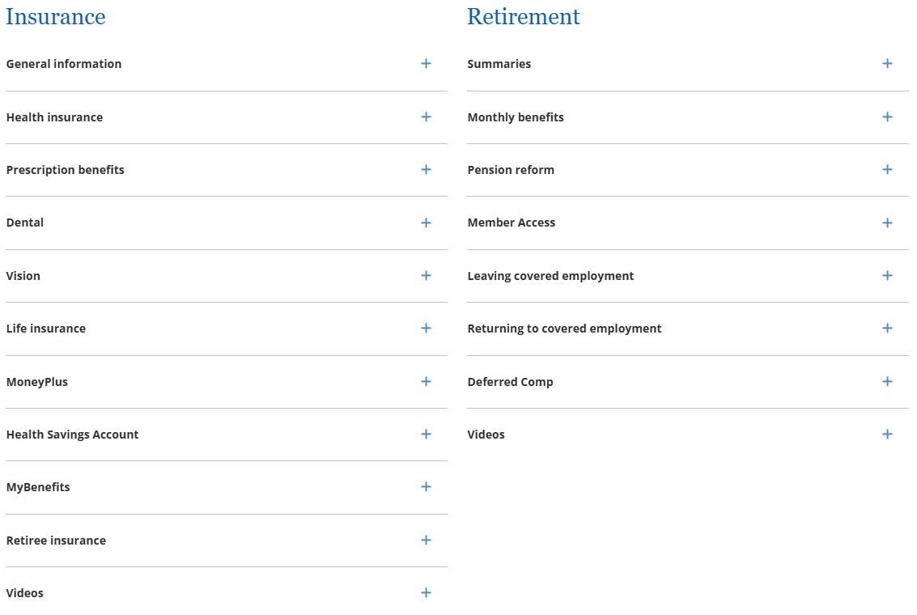

Navigating Your Benefits peba.sc.gov/nyb
Provides common-language explanations to help employees easily understand their insurance and retirement benefits.

Slide 13
Contracted vendors
PEBA does not approve or endorse companies or their products without having a legal, contractual relationship with that company.
If a company approaches you and says they are “PEBA approved,” and you have not been informed by PEBA, be cautious.
  Notify PEBA by emailing EmployerServices@peba.sc.gov.
PEBA will always inform participating employers of new vendors, service providers and program administrators.
Contract updates for January 1, 2025
Vision awarded to EyeMed.
  Initial contract period: January 1, 2025, to December 31, 2026.
Long term disability awarded to The Standard.
  Initial contract period: January 1, 2025, to December 31, 2027.
Deferred Comp awarded to Empower.
  Initial contract period: January 1, 2025, to December 31, 2027.

Slide 14
Insurance

Slide 15
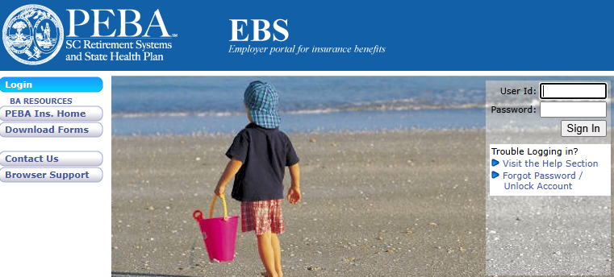
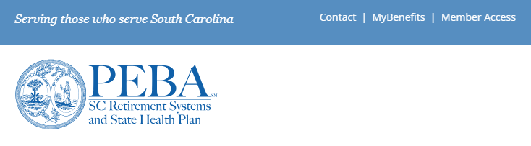
Contacting PEBA Customer Service
Insurance employers can email Customer Service directly by selecting Contact Us in EBS or completing the form at peba.sc.gov/contact-employer.

Slide 16
Post-open enrollment
Open enrollment mail must be postmarked by Friday, November 15.
Deadline for employers to approve MyBenefits transactions is Monday, December 2.
Prepare and issue the COBRA initial notice(s), if applicable.
  Newly eligible employee enrolls in health, dental, vision or Medical Spending Account.
  Employee or dependent(s) enrolls in health, dental, vision or Medical Spending Account for the first time and is not already covered by another COBRA-eligible benefit during open enrollment.
In December, view EBS enrollment report HIS759 for a list of open enrollment transactions that have not been approved. PEBA will purge outstanding transactions in mid-December.
Confirm January 2025 payroll deductions correspond with approved open enrollment transactions.
  Also advise employees to review their payroll deductions in January 2025.

Slide 17
New hires and transfers through December 31
Submit new hire enrollments in EBS for employees to elect coverage in MyBenefits.
  Flexible spending account elections are through Tuesday, December 31, only.
  To elect a flexible spending account for 2025, submit a 2025 Active Notice of Election. Indicate “New Hire - OE” with an effective date of January 1, 2025.
If applicable, transfers with no break in coverage must notify their new employer of any open enrollment elections made in October with the losing employer.
  Complete Active Notice of Election as Transfer with new employer.
A losing employer must process and send any outstanding requests for Optional Life increases to PEBA before the transfer effective date.
  Employee must notify new employer of their approved increase.

Slide 18
Special eligibility situations through December 31
If an employee completed open enrollment elections for 2025, then experiences a special eligibility situation that impacts their 2024 coverage:
  Complete a 2024 Active Notice of Election for the special eligibility situation.
  Complete a 2025 Active Notice of Election marked “Revised” for any open enrollment changes.
  Submit both to PEBA via mail.
Example:
Employee enrolls in employee/child health coverage for 2025 during open enrollment.
In November 2024, their spouse loses health coverage.
Submit a 2024 Active Notice of Election to add spouse to health coverage, effective the date of the loss of coverage.
Also submit a revised open enrollment 2025 Active Notice of Election to:
  Elect full family health coverage for 2025; or
  Confirm employee/child health coverage for 2025.

Slide 19
Plan changes for 2025
Normal Plan provisions (copayments and coinsurance) will apply to members who receive care at a Patient-Centered Medical Home (PCMH).
Members will pay the applicable brand copayment for higher-cost diabetic products and supplies, such as continuous glucose monitors (CGMs) and insulin pumps.
  No-Pay Copay participants will pay a reduced copayment for these higher-cost products and supplies.
  Impacted members received a change letter.
Supplies and drugs to treat diabetes will not be eligible for the No-Pay Copay program for Savings Plan members.
A new tobacco cessation will offer participants an option of live interactive online sessions or a self-paced structured program.

Slide 20
National Preferred Formulary for 2025
Some drugs will be excluded from coverage under the National Preferred Formulary (NPF).
  Impacted members received an exclusion letter.
Some drugs will change from a Tier 2 drug to a Tier 3 drug.
  Impacted members received a tier change letter.
Prior authorization is required for certain ADHD medications effective on the member’s 19th birthday.
  Impacted members who turn 19 during plan year 2025 received a letter.
Humira will be excluded, and Humira biosimilars will be preferred.
  The Humira biosimilars will help provide savings to members, as well as the State Health Plan.
  Impacted members received an exclusion letter.

Slide 21
IRS announces increase to MSA contribution limit
In October, the IRS announced an increase in the contribution limit for Medical Spending Accounts (MSAs) and Limited-use MSAs for 2025.
The limit increased from $3,200 to $3,300.
Eligible employees could enroll through the end of open enrollment, which was Thursday, October 31.
  The deadline for elections was not extended.

Slide 22
IRS announces increase in MSA carryover
The IRS also increased the carryover amount of unused funds for 2025.
The maximum carryover amount increased from $640 to $660.
Participants can carry over into 2026 up to $660 in unused funds from their account.
  Participants forfeit funds over $660 left in their account after the March 31, 2026, reimbursement deadline.

Slide 23
Life insurance claims
After an employer submits a death in EBS, PEBA sends the information to MetLife for those with life insurance coverage.
Reply to the encrypted email you receive from PEBA with the required information.
  PEBA will initiate this encrypted process after you report the death in EBS.
PEBA will send the beneficiary a condolence letter and beneficiary statement.
  PEBA will request an original certified death certificate.
  The beneficiary should mail the beneficiary statement and original certified death certificate to MetLife or send via fax.
Employers should not use MetLink to file life insurance claims.

Slide 24
Retirement

Slide 25
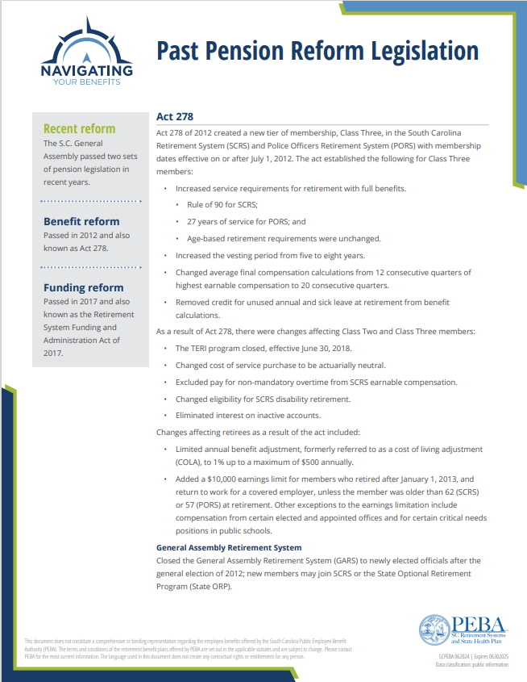
Past pension reform legislation
In 2012 and 2017, the S.C. General Assembly passed two sets of pension legislation:
  Benefit reform through Act 278 of 2012.
  Funding reform through Retirement System Funding and Administration Act of 2017.
View the Past Pension Reform Legislation flyer on our Navigating Your Benefits series.

Slide 26
Past pension reform legislation
Act 278 of 2012
Created a new tier of membership, Class Three, with membership dates effective on or after July 1, 2012.
  Class Three and Class Two at a glance flyers.
Added a $10,000 earnings limit for members who retired after January 1, 2013, and return to work for a covered employer, unless the member was older than 62 (SCRS) or 57 (PORS) at retirement.
Retirement System Funding and Administration Act of 2017
Legislation did not change the benefits provided to members of the retirement systems. Instead, the goal was to pay down the unfunded liability.
  Reducing the funding period;
  Increasing contribution rates; and
  Decreasing negative amortization.

Slide 27
SCRS, PORS membership classes
Class Two
Class Three
Earned service began prior to July 1, 2012
Earned service began on or after July 1, 2012
Membership class affects:
  Service retirement eligibility;
  Average final compensation calculation; and
  Credit for unused leave at retirement.
Share the appropriate at a Glance flyer with employees.

Slide 28
Return-to-work retirees
To retire, a member must completely terminate from all covered employment.
To receive retirement benefits, a member must also be retired for at least 30 consecutive days before returning to covered employment.
When a retiree returns to work, they must contribute a percentage of their pay into the system. The contribution rate will be the same as it is for active employees.
  The return-to-work retiree will no longer earn service credit or receive interest on their account.
When a retiree returns to work, they may be subject to the annual earnings limitation.

Slide 29
Earnings limitation
The $10,000 earnings limitation does not limit the amount a return-to-work retiree can earn from covered employment. Instead, it limits their retirement benefit once their earnings from covered employment exceed the $10,000 limit.
Unless a return-to-work retiree meets an exception to the limitation, they will receive their retirement benefit until they earn $10,000 from employment in a covered position during a calendar year.
At that time, their monthly retirement benefit stops for the rest of the year. The limit resets the following calendar year. The limit remains in effect for as long as they have covered employment.
There are several exceptions to the earnings limitation, which are outlined in the following resources:
  Covered Employer Procedures Manual;
  How Returning to Work Will Impact Your Retirement Benefits flyer; and
  peba.sc.gov/returning.

Slide 30
Exceptions to the earnings limitation via proviso in the fiscal year 2025 budget
Class One law enforcement officers who retired under PORS prior to January 1, 2023, and are employed as critical needs school resource officers. PEBA must be notified of the officer’s exemption.
  Submit Form 7214, School Resource Officer Critical Needs Certification, to certify a return-to-work retiree’s eligibility for this exemption.
SCRS and PORS retirees who had a period of at least 12 consecutive months after retirement, during which the member did not work for any covered employer in any capacity. Members must certify to PEBA that they qualify for this exemption.
  A return-to-work retiree must submit Form 7218, 12-Month Break-in-Service Exemption Certification, to certify their eligibility for this exemption.

Slide 31
COVID-19 earnings limitation exception
The earnings limitation for SCRS and PORS retirees who returned to work to participate in the state’s public health preparedness and response to the COVID-19 virus was not included in the fiscal year 2025 budget.
As such, return-to-work retirees who qualified for this exemption in fiscal year 2024 are now subject to the earnings limitation, beginning July 1, 2024, if they do not meet another exemption.
Form 7216, COVID-19 Earnings Limitation Exception, is no longer available on the PEBA website.

Slide 32
Retirement contributions
Generally, as a condition of employment, all eligible employees of employers participating in SCRS or PORS are required to become members of the applicable system, unless a statutory exemption exists and is exercised in a timely manner.
Members of SCRS and PORS, and State ORP participants, are required to contribute a portion of their earnable compensation to their retirement plan.
Employer contributions are due on amounts considered earnable compensation for both active members and retirees who have returned to work.
Employers are required to pay all applicable employer contributions, including the retiree insurance surcharge, and incidental death benefit and accidental death program coverage contributions, if coverage is provided.

Slide 33
Setting contribution rates
The S.C. General Assembly sets retirement system rules, including contribution rates.
PEBA required to hire actuary, who:
  Conducts annual actuarial valuations;
  Completes experience study every four years; and
  Develops fiscal impact statements.
Actuary studies issues, including:
  Economic assumptions, such as investment return;
  Demographic assumptions, such as member longevity; and
  Actuarial methods and policies.

Slide 34
Open enrollment for State ORP
The annual open enrollment period for active participants of State ORP is January 1 to March 1.
  Active participants may change service providers.
  Eligible participants have option to make an irrevocable switch to SCRS.
  Changes become effective on April 1, 2025.
PEBA will email State ORP participants for whom we have a valid email address on file; however, employers remain responsible for notifying all participants.
Review the State ORP chapter of the Covered Employer Procedures Manual for procedural details.
More information is available at peba.sc.gov/state-orp.

