Slide 1
Terminating coverage
Retirement, Disability and Death
2024

Slide 2
Important information
This overview is not meant to serve as a comprehensive description of the insurance benefits offered by PEBA.
More information can be found in the following:
Benefits Administrator Manual; and
Insurance Benefits Guide.
The plan of benefits documents and benefits contracts contain complete descriptions of the health and dental plans and all other insurance benefits. Their terms and conditions govern all health benefits offered by or through PEBA.

Slide 3
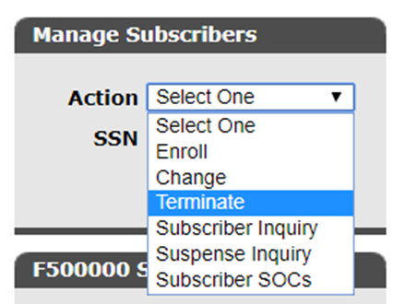
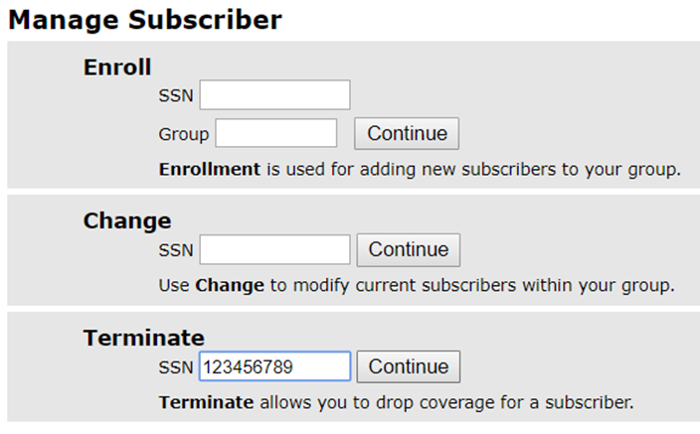
Manage subscribers

Slide 4
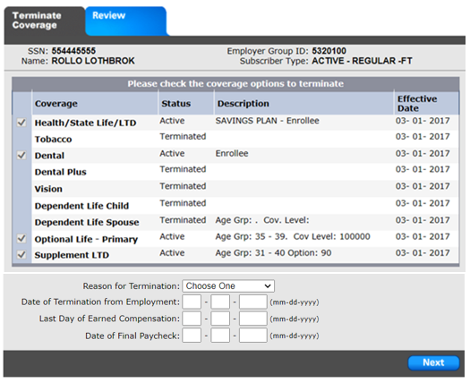
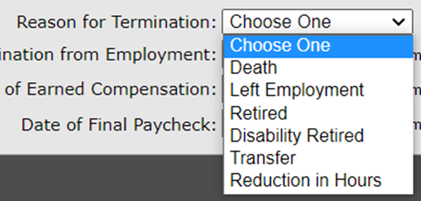
Termination details
Note: The “Reduction in Hours” reason is for those who are voluntarily dropping benefits.

Slide 5
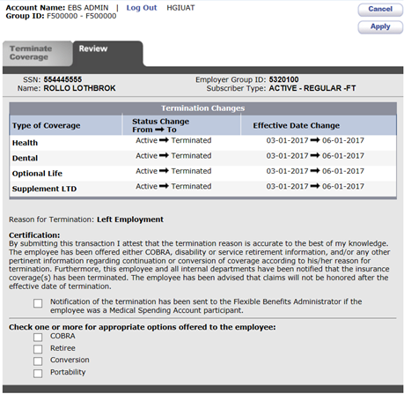
Review and apply

Slide 6
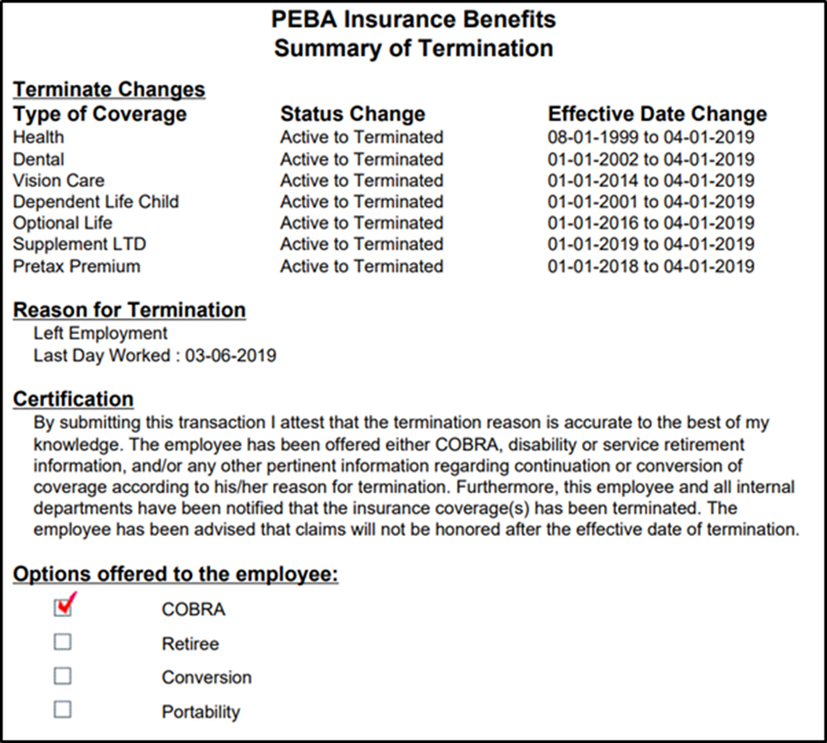
Summary of Termination

Slide 7
Terminating coverage
Send COBRA notification, available at peba.sc.gov/forms.
Service and disability retirement.
Provide employee with Retiree Packet and life event checklist.
MetLife will mail continuation and/or conversion forms directly to retiree, if applicable.
Terminations.
MetLife will mail a conversion form directly to employee.
Request Long Term Disability conversion material from The Standard, if applicable.
Death.
Provide survivor with enrollment forms and life event checklist.

Slide 8
Terminating coverage
If you do not submit the termination in EBS, submit the Active Termination Form to PEBA.
Resigned, terminated from employment or not eligible (T5).
Service retirement (T7).
Disability retirement (T2).
Death (T1).
Delays in processing might occur for paper form submissions.

